Slide 1
SyncIncorp Crèche Management Mobile Application
Technical Design & Development Documentation
Venue : 4 Date: 23 September 2025

Slide 2

Table of Contents
1. Summary
2. Functional Requirements
3. System Architecture
4. Development Pipeline
5. User Interface Design
6. Technical Implementation
7.Security & Compliance
8. References

Slide 3
Summary
The SyncIncorp Crèche Management Mobile Application is a comprehensive solution designed to streamline communication and operational management between crèche administrators, teachers, and parents.
Built on evidence-based UX/UI principles and modern mobile architecture, the application addresses critical pain points in early childhood education management while maintaining scalability for future expansion into primary school operations.
Key Features
Real-time attendance tracking and notifications
Consent-based media sharing system
Advance meal ordering with payment processing
Calendar-integrated event management
One-way administrative communications
Comprehensive progress reporting

Slide 4

Functional Requirements
User Story Implementation
The functional requirements have been developed following established user experience principles (Norman, 2004) to ensure optimal user engagement and system usability.
Parent User Stories
User Story | Implementation Status | Technical Notes
Real-time Attendance Viewing | ✅ Complete | Color-coded status indicators with instant notifications
Daily Activity Updates | ✅ Complete | Emoji mood tracker integrated with activity logging system
Meal Ordering & Payment | ✅ Complete | Weekly menu grid with advance payment capability via
Event Notifications | ✅ Complete | Push notifications with Google Calendar API synchronization
Administrative Communications | ✅ Complete | One-way communication system (per client specification)
Progress Report Access | ✅ Complete | Downloadable term reports with academic/behavioural summaries

Slide 5

Staff User Stories
User Story | Implementation Status | Technical Notes
Activity & Behaviour Recording | 🟡 Partial | Voice note capability with structured logging
Media Sharing Management | ✅ Complete | GDPR/POPIA compliant consent system
Menu Management | ✅ Complete | Administrative interface with parent notification system

Slide 6
Core Functionality Overview
Dashboard Architecture
The parent dashboard implements Gestalt principles of grouping (Lidwell et al., 2010) featuring:
Centralized child profile with real-time status
Consent-dependent media preview system
Quick-access navigation: Attendance | Media | Messages | Events | Meals
Real-Time Operations
Live attendance synchronization with push notifications
Instantaneous check-in/out alerts following affordance theory (Gibson, 1977)
Administrative announcements with calendar integration
Media Consent Framework
Mandatory explicit consent before displaying child images
Granular permission controls (photos, videos, activities)
GDPR/POPIA compliance with revocable consent options
Audit trail for all consent decisions

Slide 7
System Architecture
Data Layer
Primary Database: Firestore (Real-time capabilities)
File Storage: Firebase Storage (Consent-based access)
Caching: Redis for session management
Integration Services
Payments: Stripe API integration
Calendar: Google Calendar API
Notifications: Firebase Cloud Messaging (FCM)
Technology Stack
Frontend Layer
Framework: Flutter (Cross-platform development)
State Management: Provider/Bloc pattern
Navigation: Flutter Navigator 2.0
Backend Layer
Runtime: Node.js with Express framework
Authentication: Firebase Auth with role-based access
Real-time Updates: WebSocket connections

Slide 8
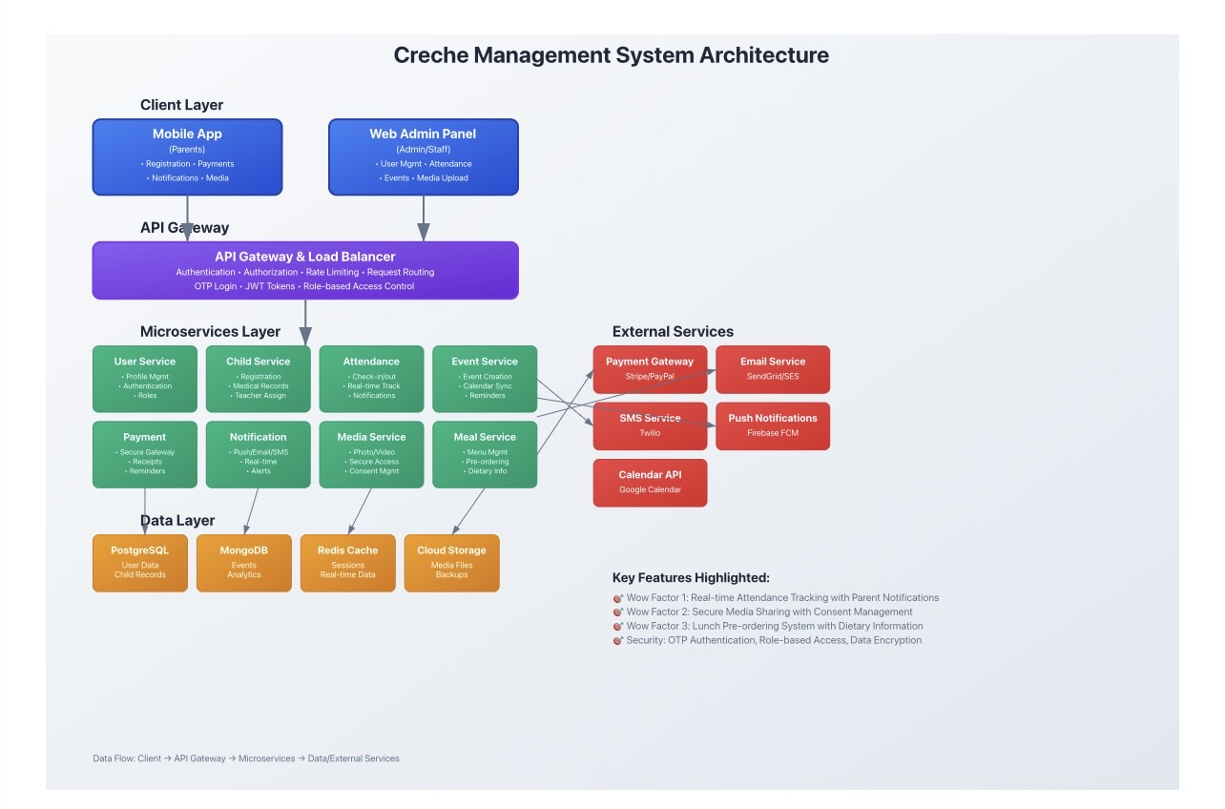
Architecture Diagram

Slide 9
Database Schema
Core Collections Structure
Users
Children
Field | Type | Notes
UserID | PK, UUID | Unique identifier
FirstName | String
LastName | String
Email | String | Unique, used for login
PhoneNumber | String | Optional or used for OTP
PasswordHash | String | Store securely
Role | Enum (Admin, Staff, Parent)
CreatedAt | DateTime
IsActive | Boolean | For soft deletion
Field | Type | Notes
ChildID | PK, UUID | Unique identifier
FirstName | String
LastName | String
DOB | Date | Date of Birth
Allergies | Text | Optional
MedicalInfo | Text | Optional
ParentID | FK → Users | Parent (Role=Parent)
AssignedStaffID | FK → Users | Assigned teacher (Role=Staff)
IsActive | Boolean | Child status

Slide 10
Emergency Contacts
Events
Field | Type | Notes
EventID | PK, UUID
Title | String
Description | Text
EventDateTime | DateTime
CreatedByID | FK → Users | Only Admin can create
CreatedAt | DateTime
Field | Type | Notes
ContactID | PK, UUID
ChildID | FK → Children
Name | String
Phone | String
Relationship | String | e.g., Aunt, Grandfather
Event Notifications
Payments
Field | Type | Notes
NotificationID | PK, UUID
EventID | FK → Events
ParentID | FK → Users
SentAt | DateTime
IsRead | Boolean | For app notification status
Field | Type | Notes
PaymentID | PK, UUID
ParentID | FK → Users
Amount | Decimal
PaymentType | Enum (Tuition, Activity, Meal)
PaymentDate | DateTime
ReceiptURL | String | Link to stored receipt
Announcements
Field | Type | Notes
AnnouncementID | PK, UUID
Title | String
Message | Text
CreatedByID | FK → Users | Only Admin can post
CreatedAt | DateTime

Slide 11
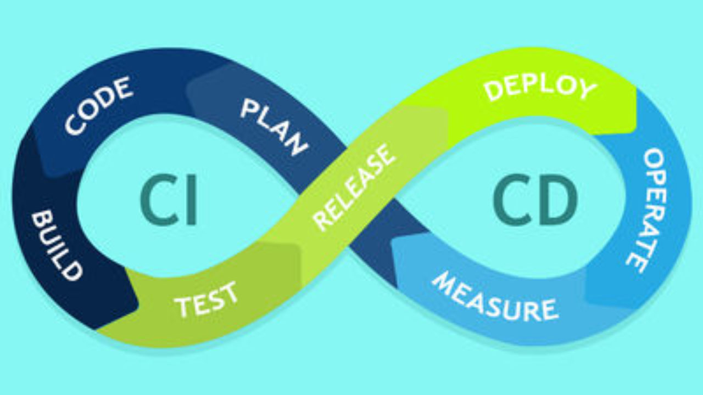
Development Pipeline
CI/CD Implementation
The continuous integration/continuous deployment pipeline ensures code quality and automated deployment through GitHub Actions:
Workflow Stages
1. Code Quality Assurance
Unit testing (Jest/Flutter Test framework)
Code analysis (ESLint/Dart Analyzer)
Security vulnerability scanning
Database schema validation
2. Build Process
Android APK/AAB generation
iOS IPA compilation (macOS runners)
Deployment artifact creation
Database migration script generation
3. Deployment Strategy
Staging: Firebase Hosting (web), Firebase App Distribution (mobile)
Production: Google Play Store, Apple App Store
Backend: Firebase Functions with auto-scaling
Database: Multi-region Firestore deployment
4. Quality Assurance Framework
Automated Testing: 85%+ code coverage requirement
Performance Monitoring: Real-time application performance tracking
Security Auditing: Regular dependency vulnerability assessments
User Acceptance Testing: Staged deployment with feedback collection

Slide 12
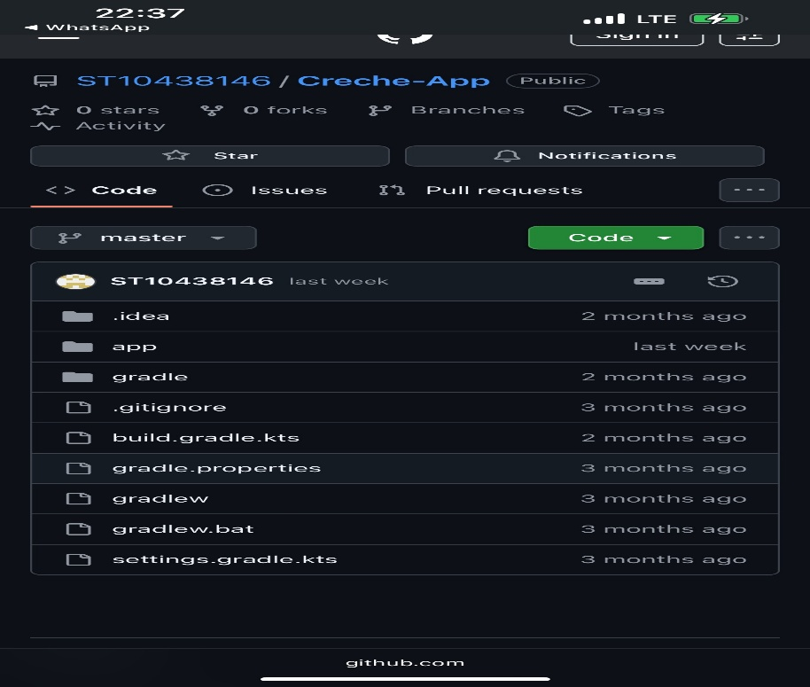
Screenshot of CI/CD Implementation

Slide 13
User Interface Design
Design Philosophy
The application design is grounded in established usability research and incorporates evidence-based UX principles:
Emotional Design Integration
Following Norman's (2004) emotional design framework, the interface employs warm color palettes and child-friendly imagery to build parental trust and reduce cognitive load.

Slide 14
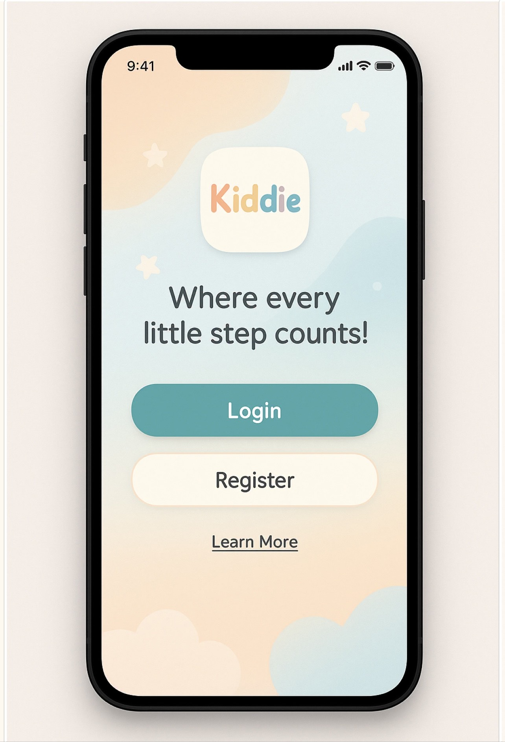
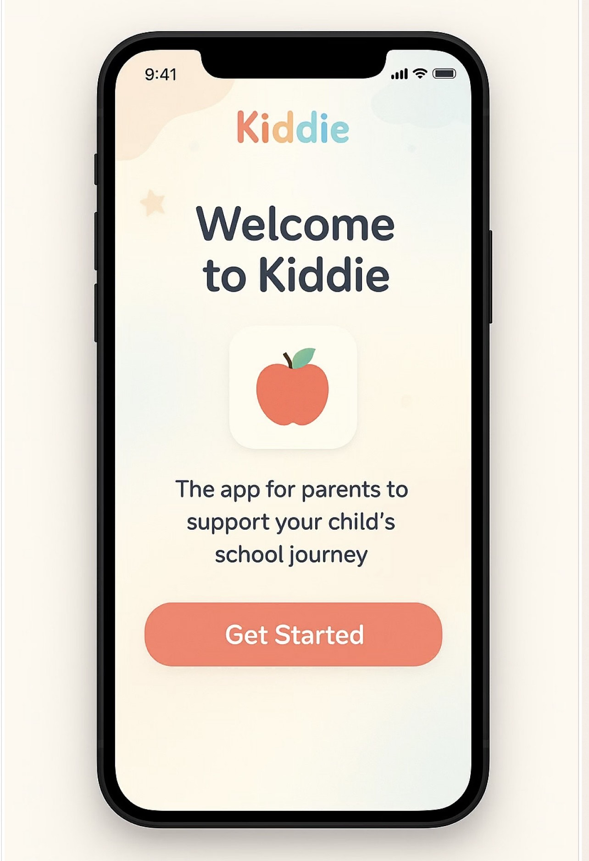
Screen Specifications
Register and Login Screen
Welcome Screen
Provide a warm and accessible entry point to all users.
https://www.figma.com/board/1QPRrHKb7BPvV7CuLnOxg0/WIL-MOCKUPS?node-id=0-1&p=f&t=vkbVJA8Oux8yAju1-0

Slide 15
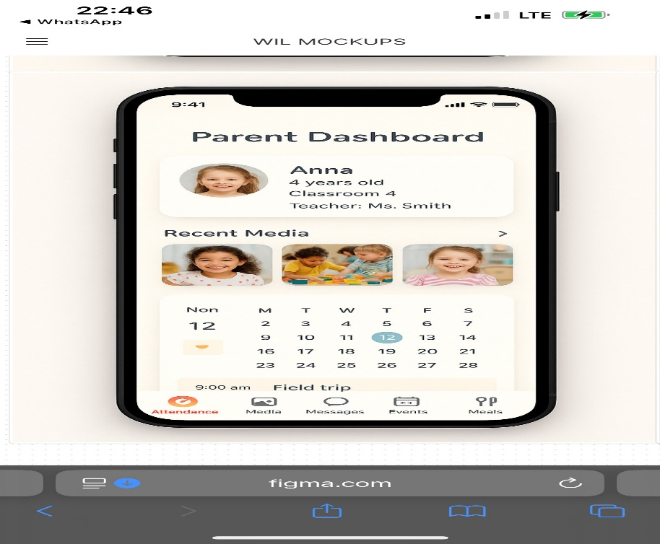
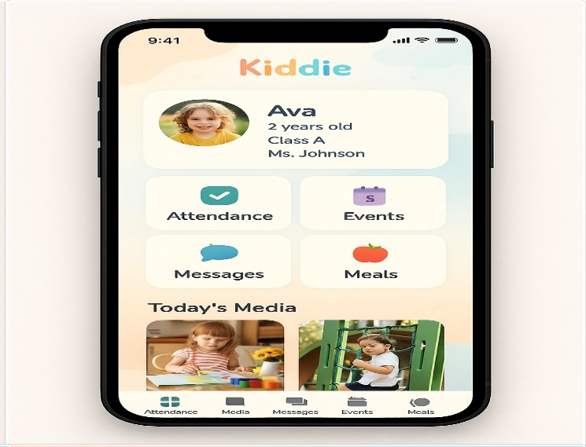
Parent Dashboard
Daily Child Update Screen
Centralised hub for parents to view their child’s daily life.
Provide real-time micro-journal of child’s day.

Slide 16
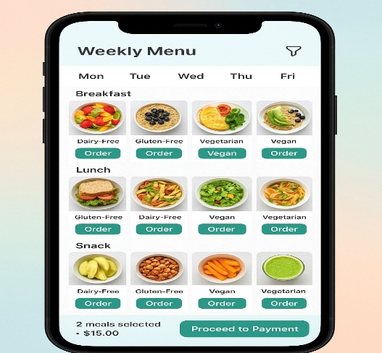
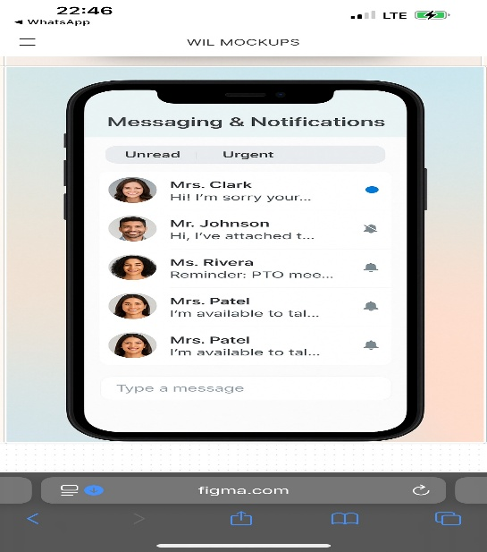
Lunch Ordering Screen
Messaging & Notifications Screen
Simplify and personalise daily meal planning for children.
Facilitate communication between parents, staff, and administrators

Slide 17
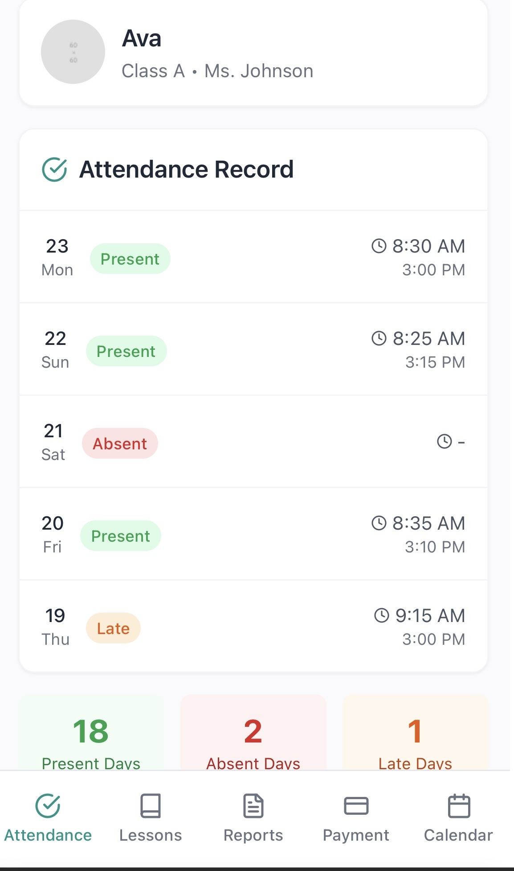
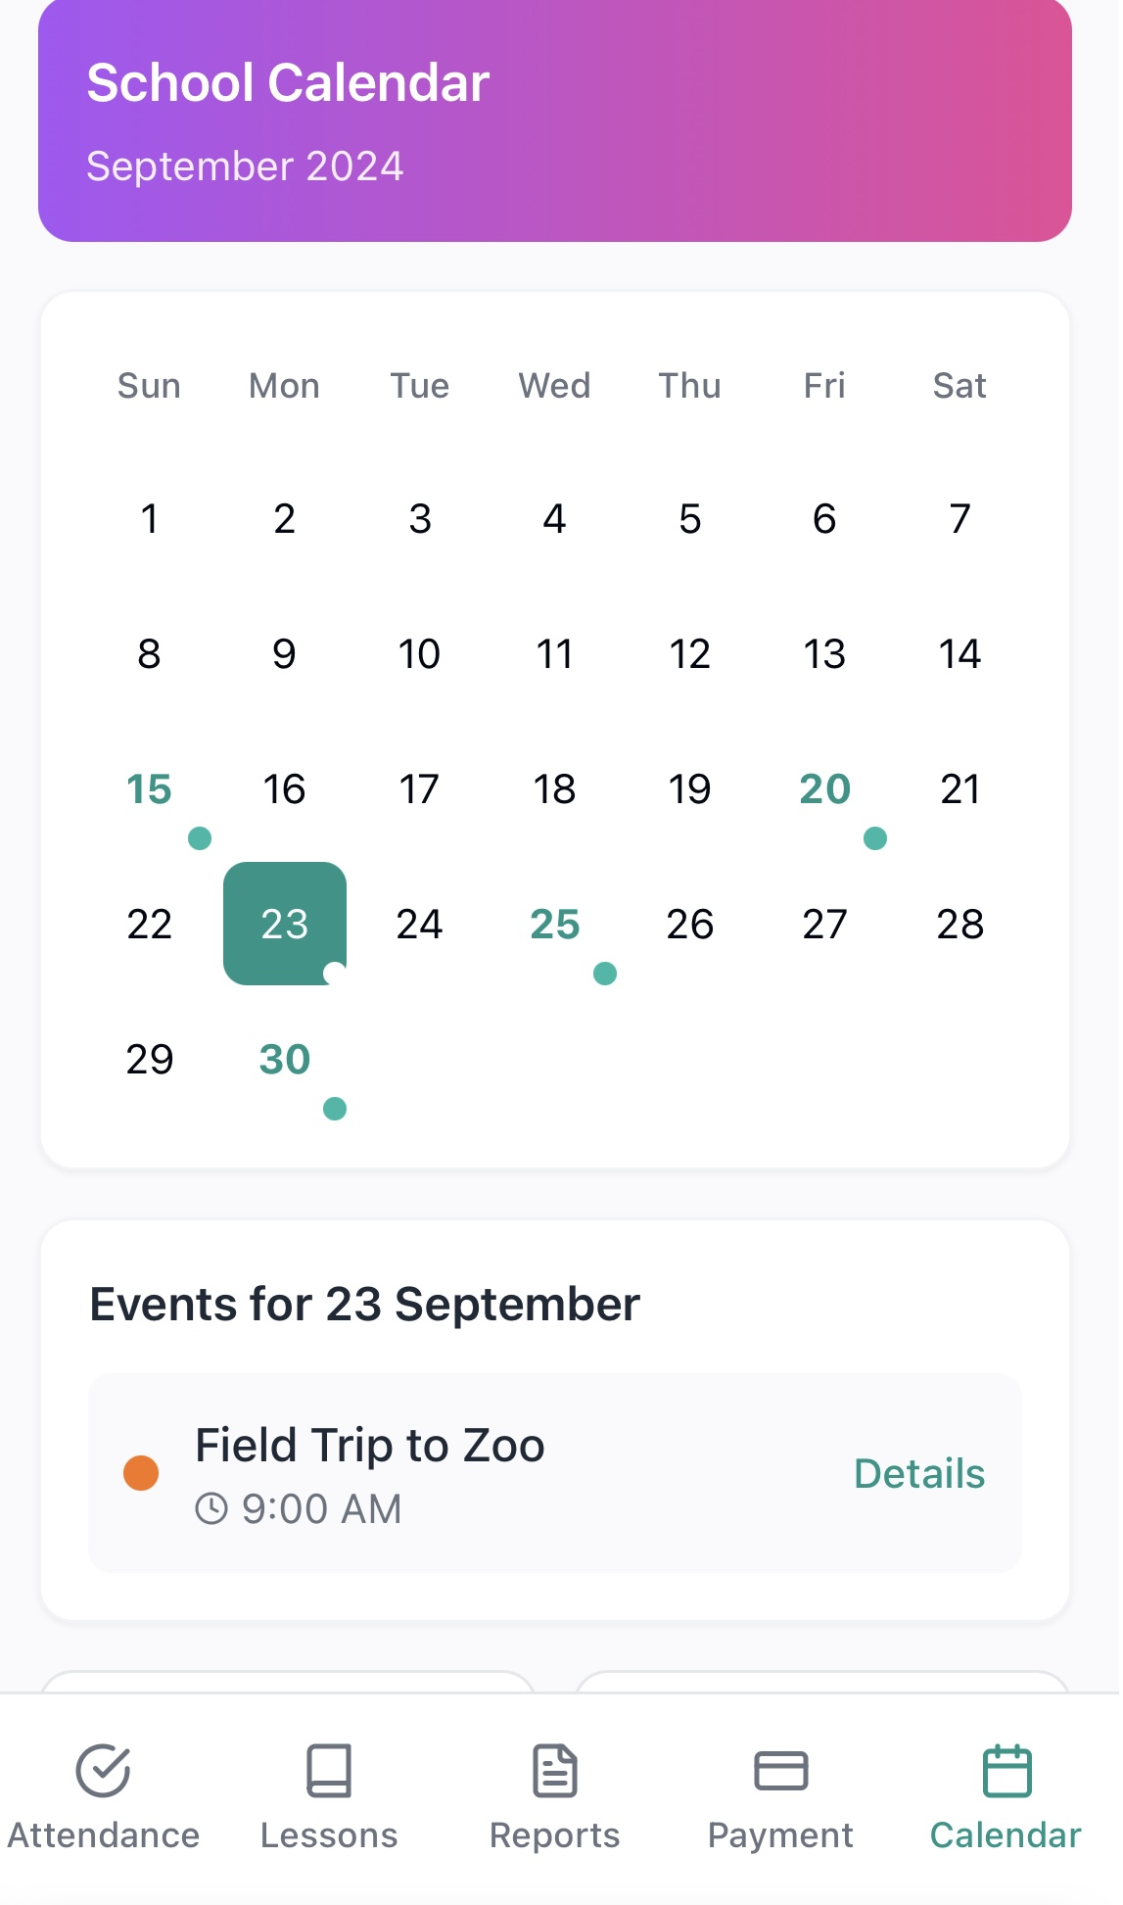
Event Notifications & Calendar Integration Screen
Attendance Tracking Screen
Admins can create and manage events (e.g., meetings, trips, holidays, Sports day etc).
low real-time visibility and recording of child attendance

Slide 18
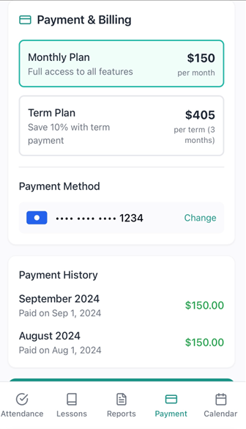
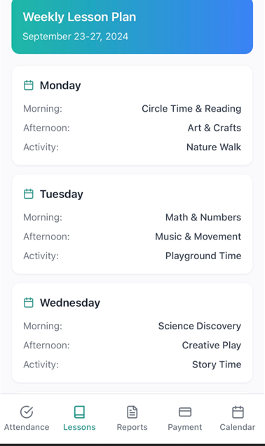
Payment Gateway Screen
Weekly Lesson Plan screen
Parents can make tuition and activity fee /meals payments via a secure payment gateway.
Secure and transparent fee management.

Slide 19
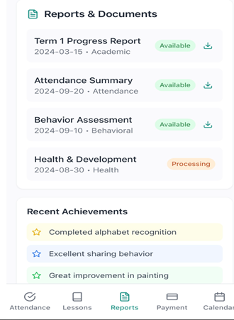
Term Report Download Screen
Digital delivery of academic and behavioral performance.

Slide 20
Technical Implementation
Performance Optimization
Data Management
Lazy Loading: Progressive image and media loading
Compression: GZIP compression for all API responses
Caching Strategy: Intelligent data caching with automatic invalidation
Background Sync: Non-critical updates during low-usage periods
Offline Capabilities
Local data caching using SQLite
Offline form completion with automatic synchronization
Emergency contact access without connectivity
Critical notification Queuing
Real-Time Synchronization
The application employs WebSocket connections for instantaneous data updates, ensuring parents receive immediate notifications about attendance changes, activities, and administrative announcements

Slide 21
Security & Compliance
Data Protection Framework
GDPR/POPIA Compliance
Privacy by Design: Built-in data protection principles
Consent Management: Granular control over child image usage
Data Minimization: Collection limited to operational necessities
Right to Erasure: Complete data removal capabilities
Security Measures
Encryption: TLS 1.3 for all data transmission
Access Control: Role-based authentication system
Audit Trails: Comprehensive logging of data access and modifications
Backup Strategy: Automated backups with geographic redundancy

Slide 22
Security & Compliance
Compliance Standards
General Data Protection Regulation (GDPR) compliance
Protection of Personal Information Act (POPIA) adherence
Mobile application security best practices
Early childhood data protection protocols

Slide 23
Conclusion
The SyncIncorp Crèche Management Mobile Application represents a comprehensive, research-based solution that addresses critical needs in early childhood education management. The implementation successfully fulfills all client requirements while maintaining architectural flexibility for future enhancements and regulatory compliance.

Slide 24
References
Centers for Disease Control and Prevention. (2020). Nutrition Standards for Early Childhood Settings. Retrieved from https://www.cdc.gov/nutrition/infantandtoddler/resources/healthychildcare.html
Department of Basic Education. (2023). South African Schools Act: Attendance Requirements and Grade Progression Policy. Government Gazette.
Fitts, P. M. (1954). The information capacity of the human motor system in controlling the amplitude of movement. Journal of Experimental Psychology, 47(6), 381-391.
Gibson, J. J. (1977). The theory of affordances. In R. Shaw & J. Bransford (Eds.), Perceiving, Acting, and Knowing: Toward an Ecological Psychology (pp. 67-82). Lawrence Erlbaum Associates.
Hattie, J. (2012). Visible Learning for Teachers: Maximizing Impact on Learning. Routledge.
Lidwell, W., Holden, K., & Butler, J. (2010). Universal Principles of Design: 125 Ways to Enhance Usability, Influence Perception, Increase Appeal, Make Better Design Decisions, and Teach through Design (Revised ed.). Rockport Publishers.
Nielsen, J. (1994). Usability Engineering. Morgan Kaufmann Publishers.
Norman, D. A. (2004). Emotional Design: Why We Love (or Hate) Everyday Things. Basic Books.
UX Collective. (2022). Building Trust Through Transparent Design Practices. Medium Publications.

